Slide 1

IPL Match Win Prediction
Harnessing data science to forecast cricket game outcomes accurately.
Leveraging machine learning for strategic advantage on the field.
Transforming cricket analytics through advanced predictive modeling.

Slide 2
Contents Overview
Introduction
Modules & Methodology
Data Collection
Data Preprocessing
Exploratory Data Analysis (EDA)
Feature Engineering
Models Used
Model Comparison
Future Scope
Conclusion

Slide 3

Introduction
Growing demand for data-driven insights in cricket.
Win prediction is complex with many influencing factors.
Key factors: Batting Team, Bowling Team, City, Targets, Overs, Wicket.
Goals: accurate predictions and gaining a competitive edge.

Slide 4
M
O
D
U
L
E
S
U
S
E
D
matplotlib
numpy
pandas
pickle
seaborn
sklearn.compose
sklearn.ensemble
sklearn.linear_model
sklearn.metrics
sklearn.model_selection
sklearn.pipeline
sklearn.preprocessing
sklearn.svm
sklearn.tree
xgboost
Modules & Methodology
Core Modules
Data ingestion, preprocessing, modeling, evaluation.
Methodology
Supervised learning selected for clarity and reliability.
Approach Justification
Machine learning fits well with historical data patterns.
Prediction Pipeline
Sequential flow from raw data to model output.

Slide 5
Data Collection
Data Sources
Data Challenges
APIs from cricket boards
Inconsistencies and missing values
Official websites and historical databases
API limitations and rate limits
Ensuring data accuracy across 10 years

Slide 6

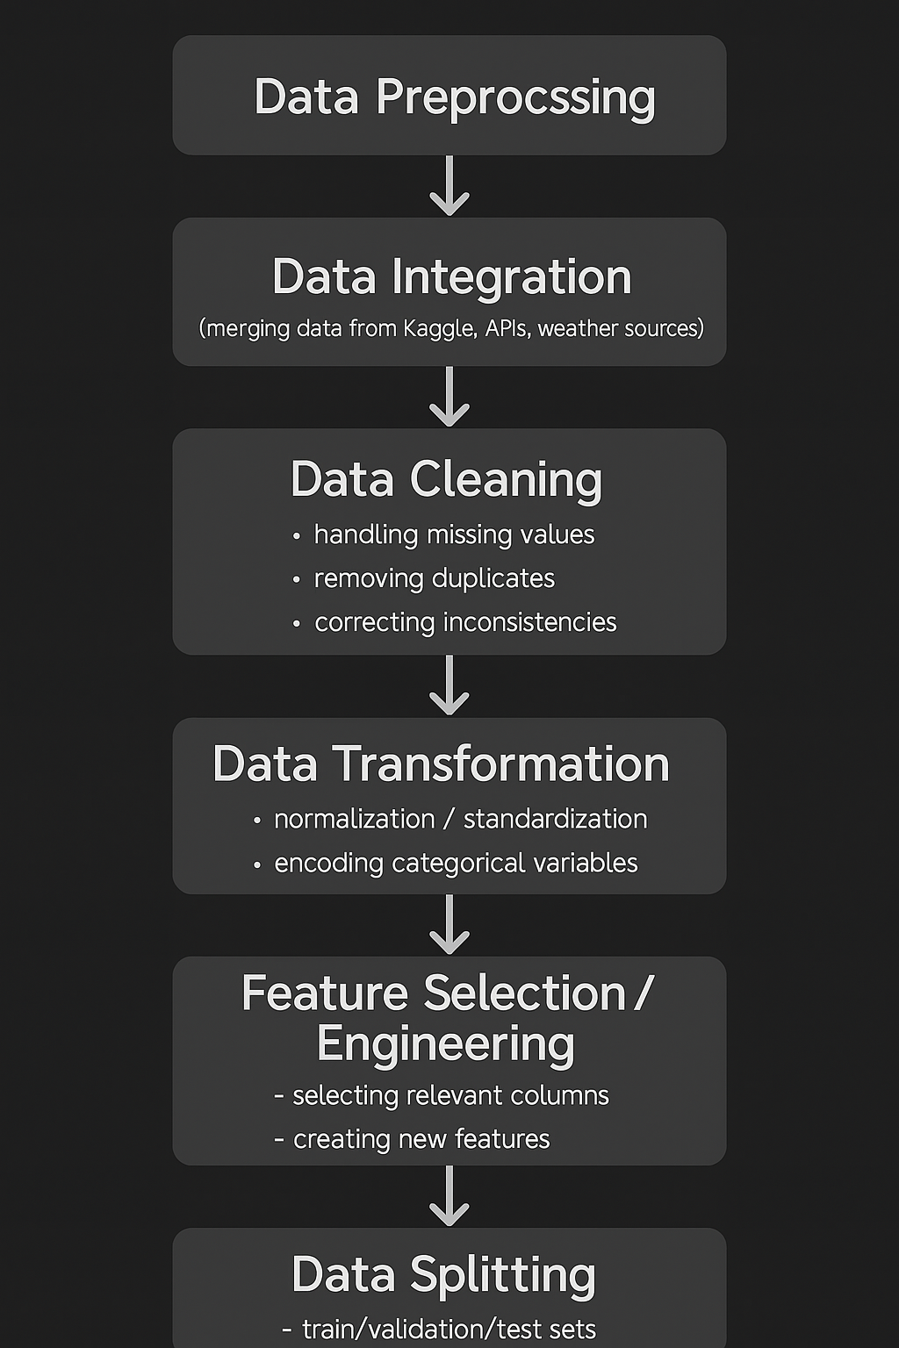
Data Preprocessing
Clean raw data to suit machine learning models.
Impute or remove missing data carefully.
Normalize and scale features for better training.
Detect and handle outliers to improve robustness.

Slide 7
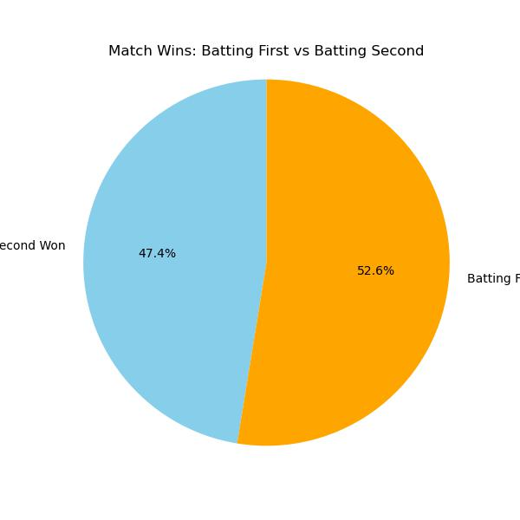
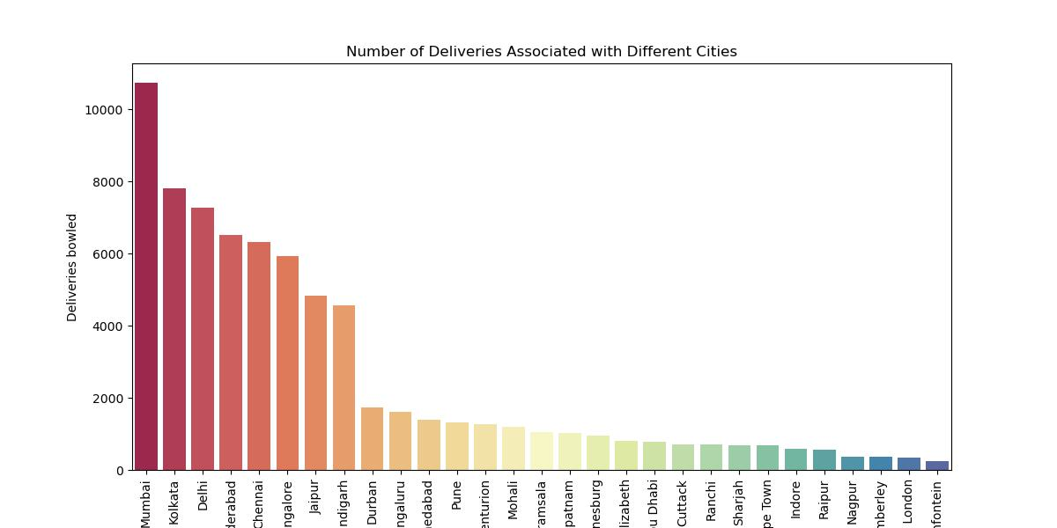
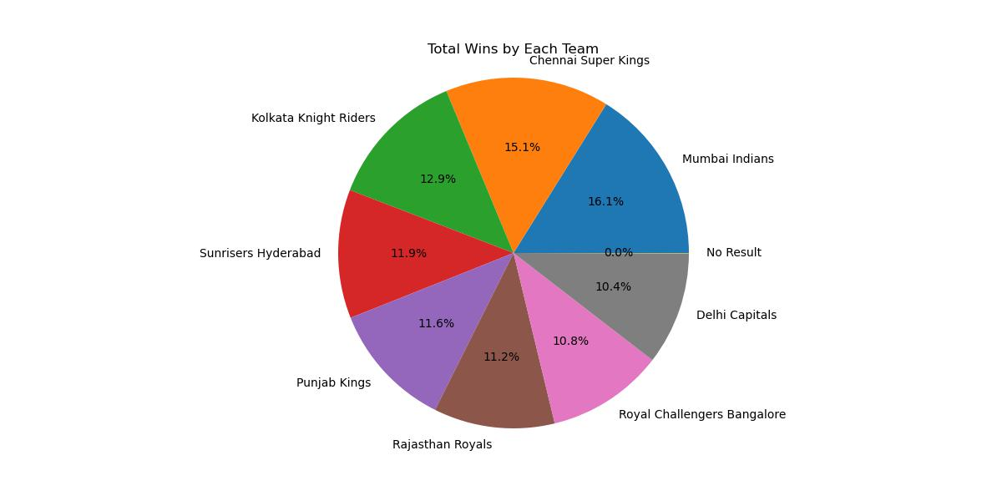
Exploratory Data Analysis (EDA)
Statistical Analysis
Visualization
Insights
Identifying distributions and correlation between features.
Histograms of batting averages
Key metrics like strike rate and economy impact outcomes.
Scatter plots for strike rates
Correlation matrices of player stats

Slide 8
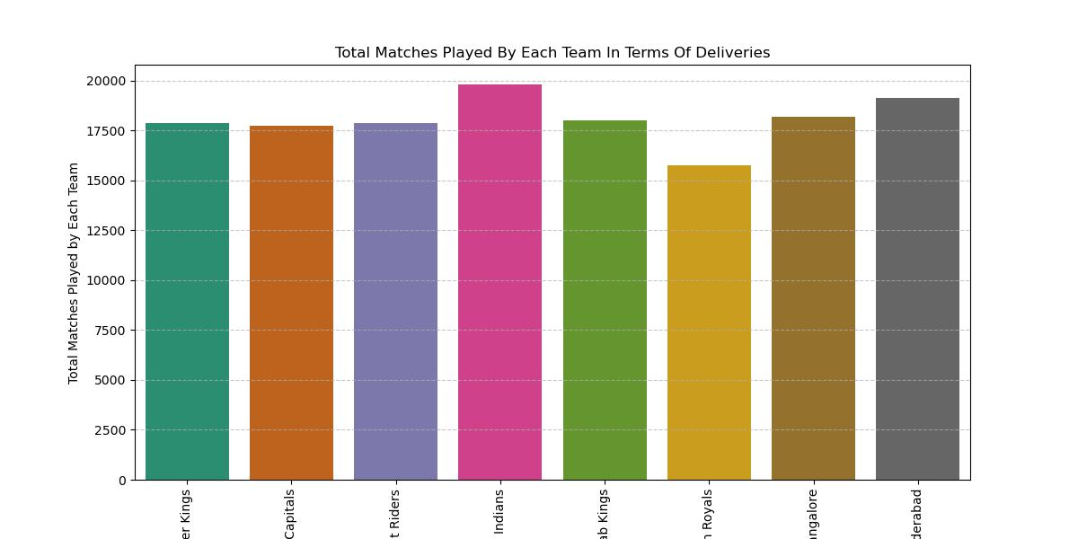
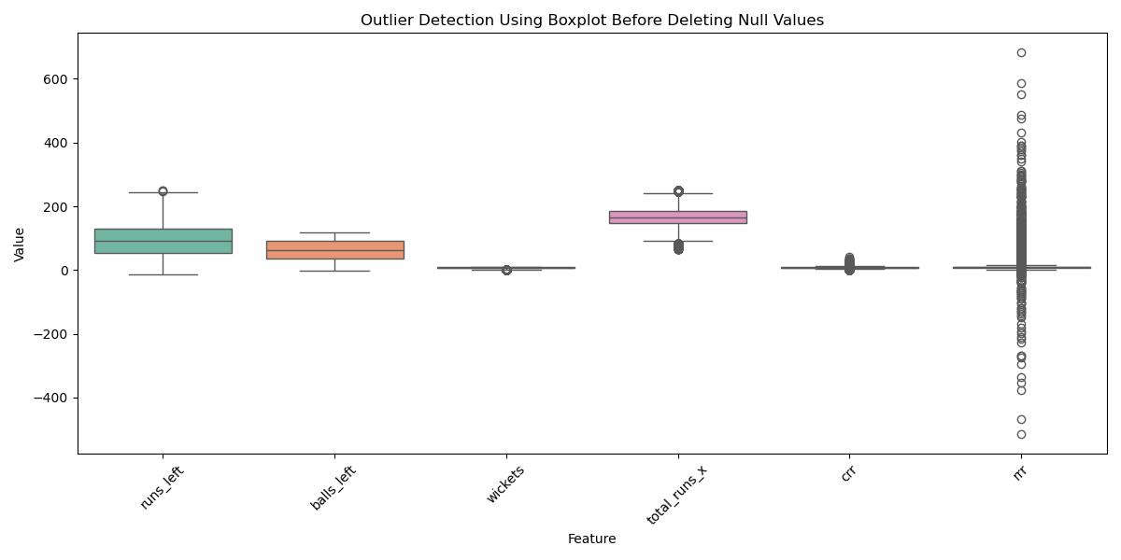
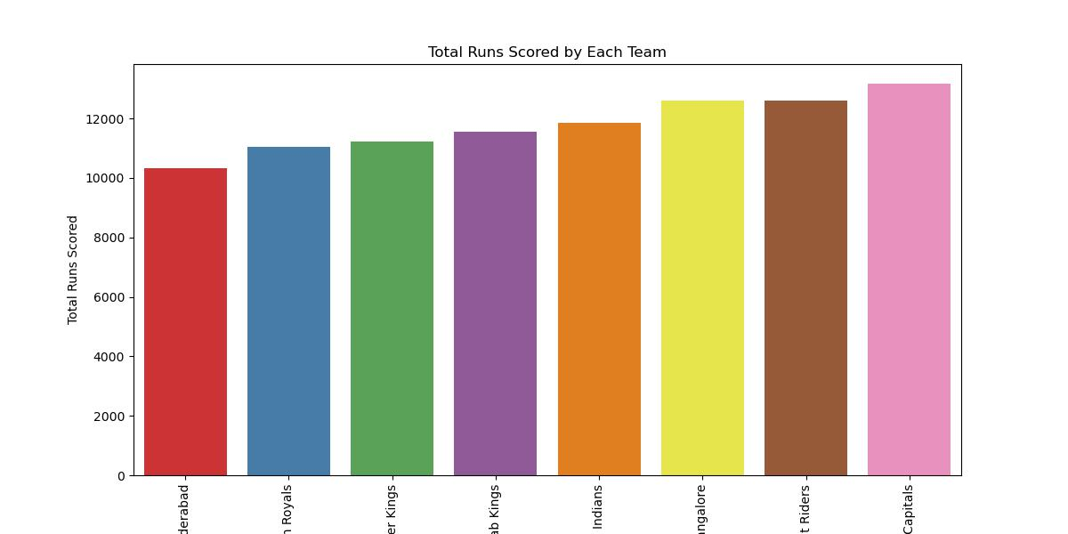
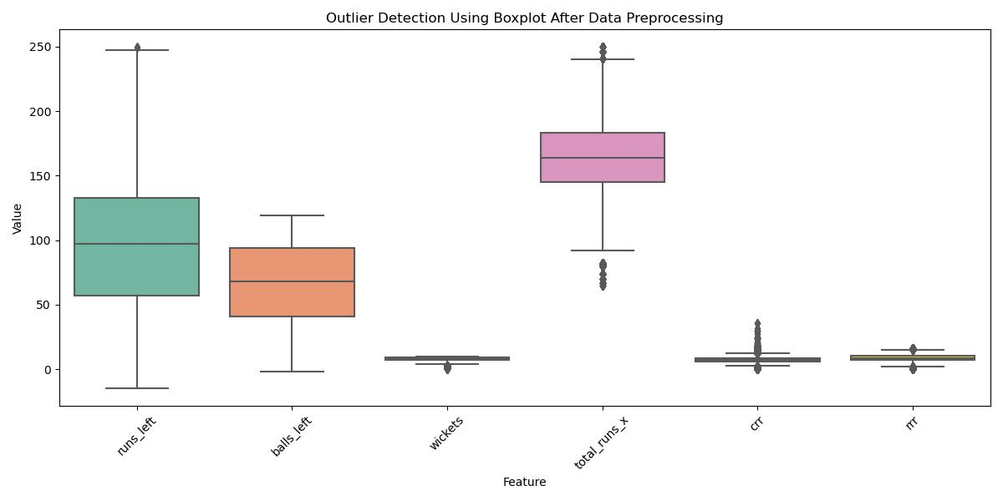

Slide 9

Feature Engineering
Features
Toss winner
Batting first or second
Venue-based team performance
Team win percentage
Feature Selection
Correlation analysis
Feature importance using model-based selection (e.g., Random Forest feature importance)
Removed low-variance or irrelevant features

Slide 10
Models Used
Models
Training
Performance Metrics
Logistic Regression
Validated via cross validation and hyperparameter tuning.
Accuracy
Random Forests
Precision, Recall
Support Vector Machine
F1-score, AUC
XGBoost
AdaBoost

Slide 11

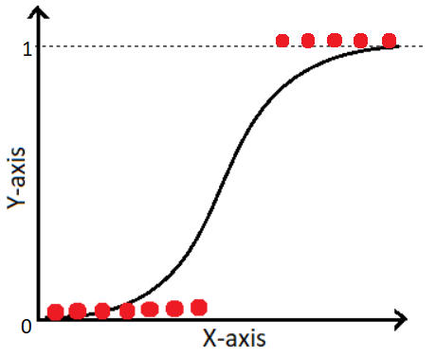
Logistic Regression
Logistic regression is a supervised machine learning algorithm used for classification tasks where the goal is to predict the probability that an instance belongs to a given class or not. Logistic regression is a statistical algorithm which analyze the relationship between two data factors.
Accuracy | 0.800969864911673
Precision | 0.8060355945318545
Recall | 0.8203176269851686
F1 Score | 0.8131139009952514

Slide 12
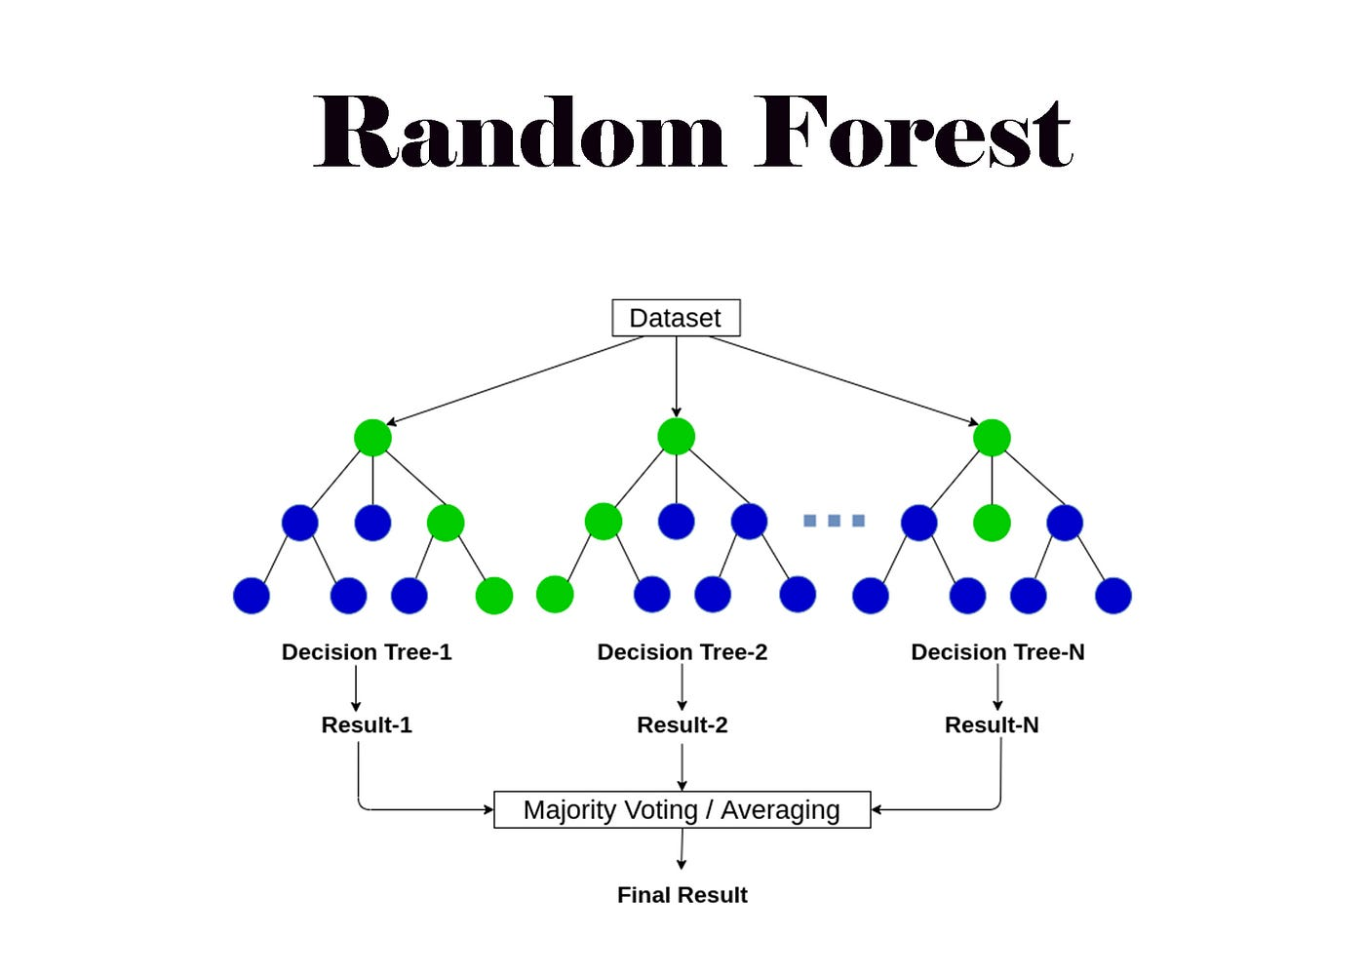
Random Forest
A Random Forest is a machine learning algorithm that uses multiple decision trees to make predictions and decisions. It's an ensemble method where each tree is trained on a random subset of the training data and a random subset of features. By combining the predictions of these trees, Random Forests often achieve higher accuracy and robustness compared to individual decision trees.
Recall
Accuracy | 0.9984066505022515
Precision | 0.9988179669030733
Recall | 0.9981624885155532
F1 Score | 0.9984901201339198

Slide 13

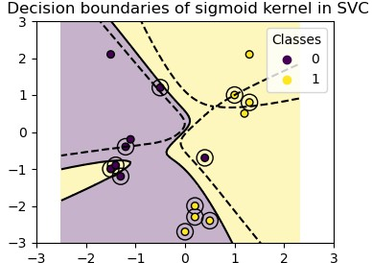
Support Vector Machine Classifier
Support Vector Machine or SVM is one of the most popular Supervised Learning algorithms, which is used for Classification as well as Regression problems. However, primarily, it is used for Classification problems in Machine Learning. The goal of the SVM algorithm is to create the best line or decision boundary that can segregate n- dimensional space into classes so that we can easily put the new data point in the correct category in the future. This best decision boundary is called a hyperplane.
Precision
Recall
Accuracy | 0.9574644960166263
Precision | 0.954811063498247
Recall | 0.9650872817955112
F1 Score | 0.9599216710182767
Accuracy
Precision

Slide 14
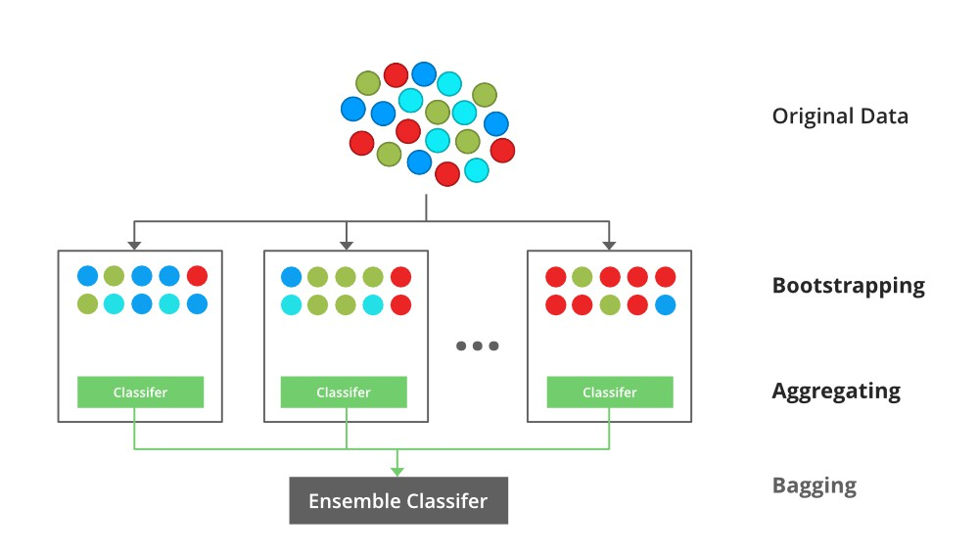
XGBoost
XGBoost is an optimized distributed gradient boosting library designed for efficient and scalable training of machine learning models. It is an ensemble learning method that combines the predictions of multiple weak models to produce a stronger prediction. XGBoost stands for “Extreme Gradient Boosting” and it has become one of the most popular and widely used machine learning algorithms due to its ability to handle large datasets and its ability to achieve state-of-the- art performance in many machine learning tasks such as classification and regression.
Accuracy | 0.9982680983720125
Precision | 0.9993424513413993
Recall | 0.9973749835936475
F1 Score | 0.9983577481442554

Slide 15
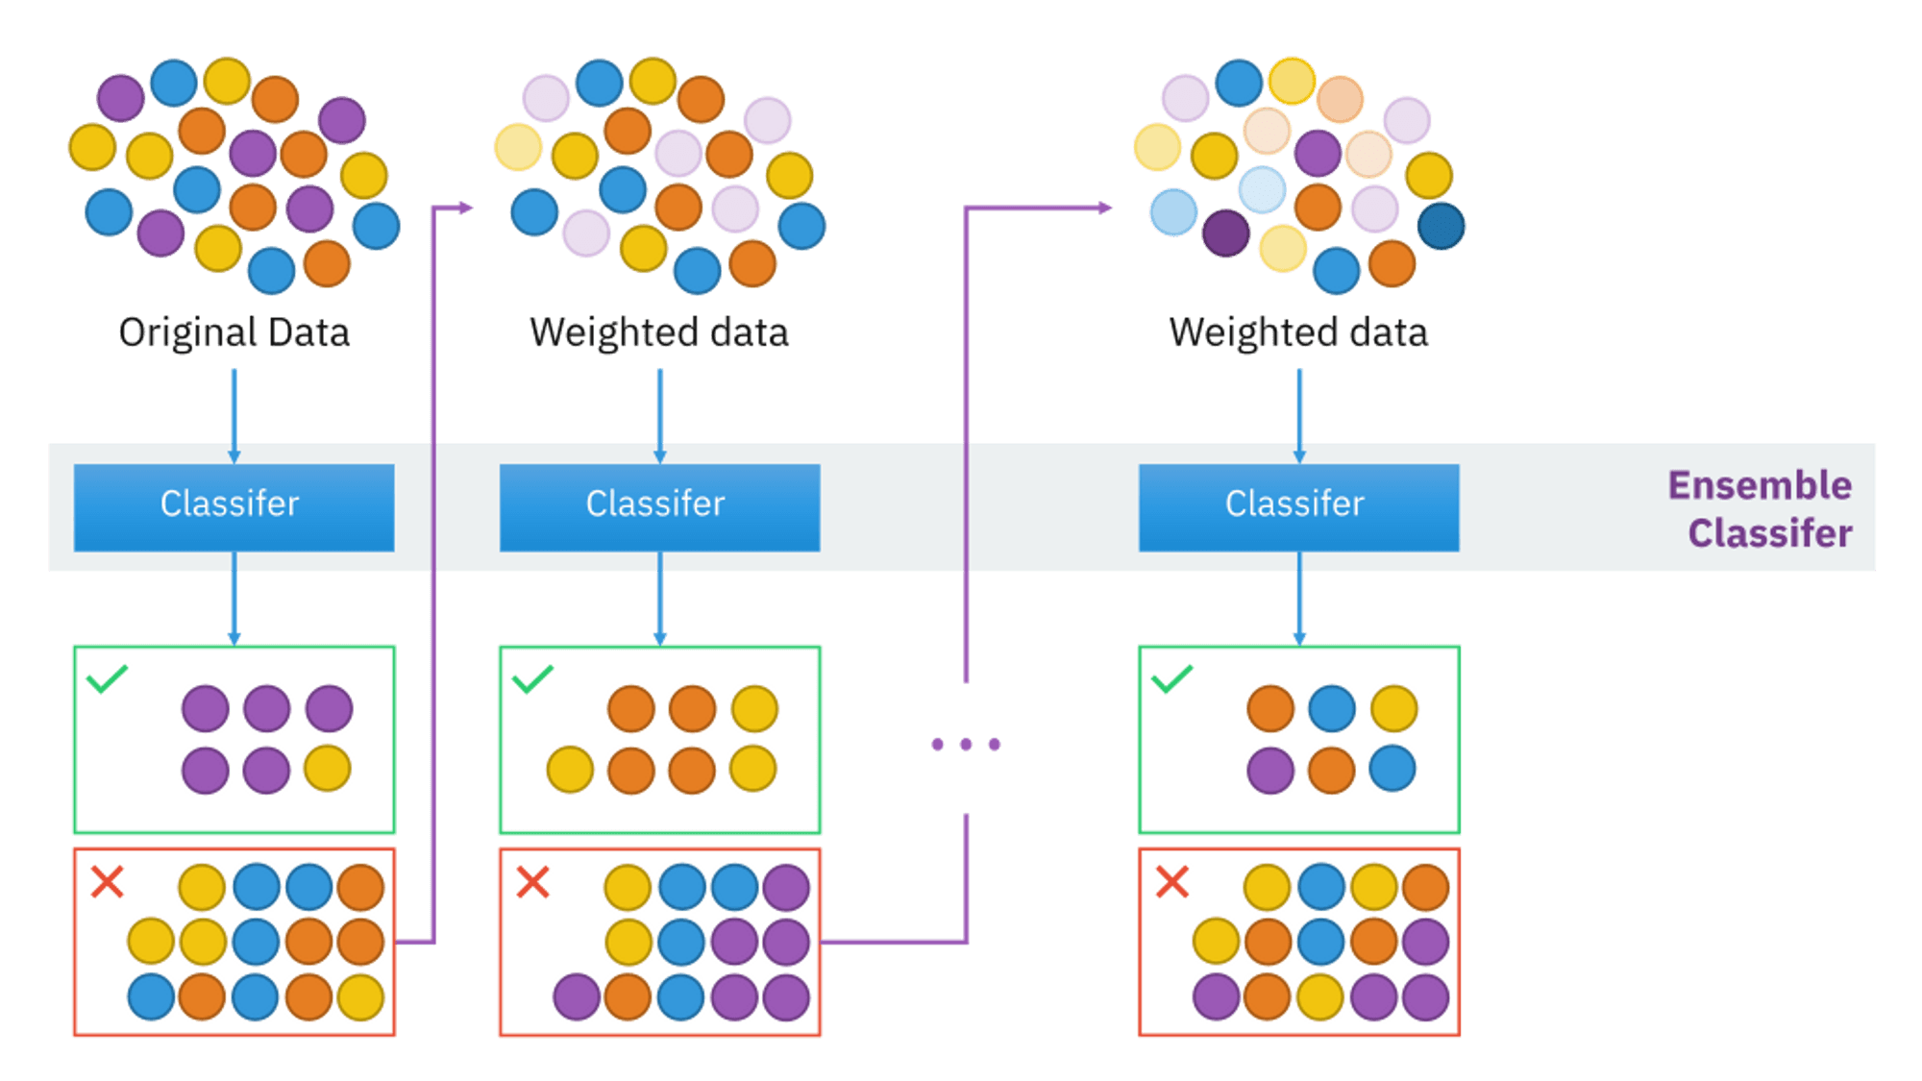
AdaBoost
AdaBoost, short for Adaptive Boosting, is a machine learning ensemble method that combines multiple "weak learners" (simple models) to create a stronger, more accurate model. It works by iteratively training weak learners, with each learner focusing on misclassified instances from the previous rounds, effectively "adapting" to the errors and improving overall performance
Accuracy | 0.7581572566678213
Precision | 0.7769726247987118
Recall | 0.7599422496390602
F1 Score | 0.7683630814146374
Recall

Slide 16



Model Comparison & Future Scope
Model Comparison
Random Forest showed best accuracy and balance.
Strengths & Weaknesses
Model | Logistic Regression | Random Forest | AdaBoost | XGBoost | Support Vector Machine
Accuracy | 0.8009 | 0.9984 | 0.7582 | 0.9982 | 0.9574
Precision | 0.8062 | 0.9988 | 0.7728 | 0.9939 | 0.9548
Recall | 0.8203 | 0.9982 | 0.759 | 0.9974 | 0.9651
F1-Score | 0.8131 | 0.9984 | 0.7658 | 0.9956 | 0.9599
Random forests excel in handling noisy data; logistic regression is interpretable.
Future Improvements
Potential to combine ensemble methods and deep learning.

Slide 17

Thank You
Project Mentor : Dr. Arnab Chakraborty
NAME | UNIVERSITY ROLL NO.
RISHABH AGARWAL | 10871023036
AKASH SEN | 10871023009
SHAIBAL PATRA | 10871023044
RAJ KUMAR JHA | 10871023035
AMAN KUMAR GUPTA | 10871023010
OUR TEAM

